Slide 1
GO Team Meeting #1
Dunbar Elementary School
9/19/2024

Slide 2
TOPICS
School Strategic Plan
Strategic Plan & Priorities Review
SMART Goals
Data Discussion
Spring MAPS
GMAS
School Uniform Discussion
Principal’s Report
Current Enrollment & Leveling
Information about our school

Slide 3
2021-2025
Strategic Plan

Slide 4
Mission Paul L. Dunbar is a school where excellence is expected, and all students are developed academically, socially, and emotionally in order to become globally competitive.
School Name: Dunbar Elementary School
Vision: Paul L. Dunbar Elementary is a school that nurtures and develops life-long learners who are problem solvers and internationally minded citizens.
SMART Goals
By May 2025, we will increase the % of students in grades 3-5 scoring proficient or above in reading by 5% from 22% to 27% and decrease students scoring beginning by 5% from 53% to 48% on MAP.
By May 2025, we will increase the % students in grades 3-5, scoring proficient or above in math by 5% from 10% to 15% and decrease students scoring beginning by 5% from 58% to 53%.
By May 2025, we will increase the % of CCRPI Attendance from 60% to 65%. (5% Growth)
APS Strategic Priorities & Initiatives
School Strategic Priorities
School Strategies
1.Offer an academically challenging curriculum that prepares students for college and career readiness
2. Effectively implement literacy curriculum to include explicit instruction
3. Effectively implement math curriculum
1A. Align the school schedule to create collaborative planning session for each teacher
1B. Aligned the instructional framework to maximize instructional time in the classroom.
1c.Integrate reading strategies and fluency facts into all exploratory courses
2a. Ensure all classroom are print –rich with Literacy Centers that focus on various reading skills
2b.. Ensure all classroom are using visual supports and engaging texts to increase literacy
3a 1Emphasize problem-solving strategies and encourage students to explain their reasoning
3b. Ensure Math Centers allows students to practice a variety of difference skills at their own pace.
Fostering Academic Excellence for All Data
Curriculum & Instruction Signature Program
Building a Culture of Student Support
Whole Child & Intervention Personalized Learning
4. Effectively use existing and appropriate tools to measure, analyze, and communicate student progress
5. Effectively monitor attendance protocols and systems
6. Create a collaborative, inclusive, and responsive school culture
4a.. Complete ongoing data protocol with teachers during collaborative planning
4B. Use if frequent common assessments , analyze date, use to guide instruction
6a .Integrate SWD professional learning to structure special education instructional framework
4c/5b. Implement a school wide behavior plan (PBIS focused) / Implement attendance Incentives
Equipping & Empowering Leaders & Staff
Strategic Staff Support Equitable Resource Allocation
7. Build teacher capacity to meet the academic needs of the students
8. Create a Supportive Work Environment that motivates and retains staff.
6a.. Implement and Monitor professional learning collaborative planning to review instructional framework
6b. Continue to build instructional teams to support the teachers and students
7a .Integrate SEL Awareness and moment to build positive work environment
9. Provide necessary resources to enhance teaching and learning in all spaces
10. Attract and build capacity of talented and knowledgeable staff to meet school needs
11. Build and sustain parent engagement, community partnerships, and student voice
8a.. Implement Wellness Days and celebrate teachers and staff for attendance, data, personal accomplishments
9a. Increase math manipulatives, literacy manipulatives, and reading centers
10a Encourage Endorsements in Reading, math, technology to increase professional knowledge.
11a. Build and sustain parent engagement, community partnerships, and student voice
Creating a System of School Support
Strategic Staff Support
Equitable Resource Allocation
TBD: tbd
14

Slide 5
Strategic Plan
Priority Ranking
Insert the school’s priorities from Higher to Lower
Higher
Offer an academically challenging curriculum that prepares students for college and career readiness
Effectively implement literacy curriculum to include explicit instruction
Effectively implement math curriculum
Effectively use existing and appropriate tools to measure, analyze, and communicate student progress
Effectively monitor attendance protocols and systems
Create a collaborative, inclusive, and responsive school culture
Build teacher capacity to meet the academic needs of the students
Create a Supportive Work Environment that motivates and retains staff.
Provide necessary resources to enhance teaching and learning in all spaces
Attract and build capacity of talented and knowledgeable staff to meet school needs
Build and sustain parent engagement, community partnerships, and student voice
Lower

Slide 6
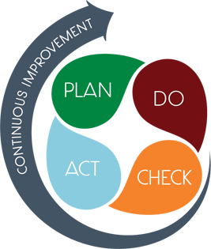
Connecting the Strategic plan &
Continuous Improvement Plan
Increase Literacy Proficiency
MAP Scores
Strategic Plan Priority
CIP SMART Goal
Key Indicator
By May 2025, we will increase the % of students in grades 3-5 scoring proficient or above in reading by 5% from 22% to 27% and decrease students scoring beginning by 5% from 53% to 48% on MAP
Increase Math Proficiency
MAP Scores
By May 2025, we will increase the % students in grades 3-5, scoring proficient or above in math by 5% from 10% to 15% and decrease students scoring beginning by 5% from 58% to 53%.
Attendance
CCRPI Attendance
By May 2025, we will increase the % of CCRPI Attendance from 60% to 65%. (5% Growth

Slide 7
Data
Discussion

Slide 8
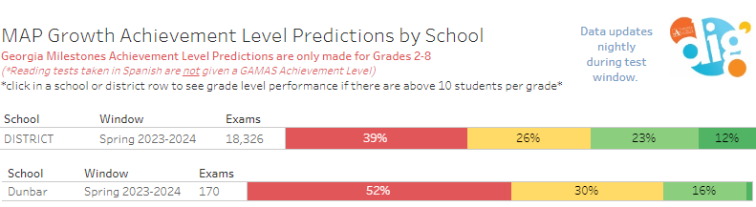
Spring MAP Results

Slide 9
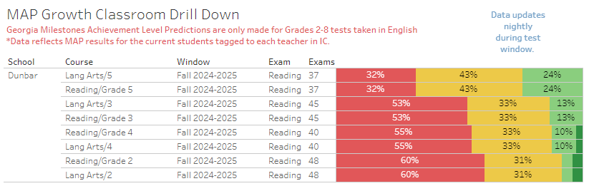
MAP Growth Classroom Drill Down

Slide 10
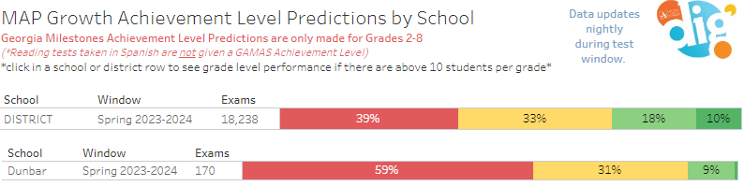
Spring Map MATH

Slide 11
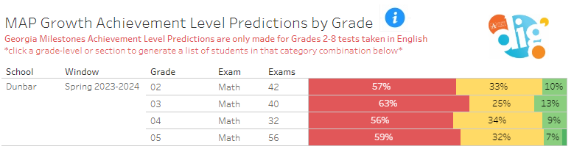
MAP GROWTH Classroom Drill Down

Slide 12
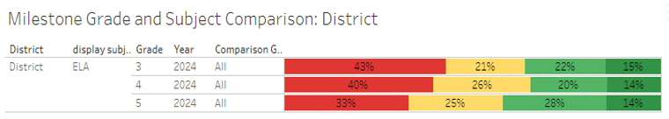

GMAS Results
Milestones Math results are embargoed by GA DOE until late September 2024. If you meet prior to the data being released, results will be shared at your next GO Team meeting.

Slide 13
Glows & Grows
Glows
Grows
% of students scoring proficient or distinguished in ELA increased by 5.9 points ( Largely driven by gains in 5th grade)
% of students scoring proficient or distinguished in Math increased 8.2 points (large gains in Grade 5)
% of students scoring proficient or distinguished in Science increased 9.6 points
Decrease the number of students scoring in beginning level in ELA in all grades
Increase the number of students scoring in proficiency levels
are we on target to successfully ACCOMPLISH our priorities?
IMPACT

Slide 14
GO Team Discussion:
Data Protocol
What do you notice?
What are your wonderings?
What additional questions do you have?

Slide 15
Timeline for GO Teams
You are HERE
Fall 2021
GO Team Developed 2021-2025 Strategic Plan
1
Summer
School Leadership completed Needs Assessment and defined overarching needs
2
August
School Leadership completed Continuous Improvement Plan
3
Sept. – Dec.
Utilizing current data, the GO Team will review & possibly update the school strategic priorities and plan
4
Before Winter Break
GO Team will take action (vote) on the rank of the strategic plan priorities for SY25-26 in preparation for budget discussions.
5

Slide 16
Questions?

Slide 17
Discussion: Optional School
Uniform

Slide 18



Optional School Uniform
In the 2023-2024 school year, the APS Board of Education updated the district’s dress code policy. As part of the update, starting with the 2025-2026 school year if a school wishes to maintain or explore implementing an optional school uniform, it must go through an engagement process and have a vote as outlined below:
Elementary
Middle
High
A school uniform is adopted upon the agreement of the principal and a majority vote of the School Governance Team (GO Team).
School uniforms are adopted upon the agreement of the principal, GO Team and the elected student government. If the school does not have an elected student government, then a majority vote must be secured from the student body to adopt a school uniform.
School uniforms are adopted upon the agreement of the principal, GO Team and the elected student government. If the school does not have an elected student government, then a majority vote must be secured from the student body to adopt a school uniform.
If your school currently has a school uniform and wishes to continue it, you must go through this process!

Slide 19
ABOE Policy JCDB
Student Dress Code
(Last Revised, 06/03/2024)
http://tinyAPS.com/?APSDressCodePolicy
Requirements
Restrictions
A top of non-see through fabric
A bottom of non-see through fabric
Shoes
Undergarments that are not visible
No words or symbols that are gang-related, sexually suggestive, obscene or promote illegal behavior
Nothing associated with alcohol, illegal drugs or tobacco
No flip-flops, athletic slides or footwear that doesn’t support the front and back of the foot

Slide 20
School-specific Dress Codes
We have one districtwide student dress code adopted
by the Atlanta Board of Education.
School-specific dress codes may not contradict Board policy.
Examples of problematic school specific dress-code provisions
“dress in good taste”
“no baggy pants”
“no short shorts or skirts”
“no tight/revealing clothing”
“no ‘extreme’ hairstyles or colors”
“all shirts must be tucked in
“hair should be clean and neatly groomed”
“no shirts which expose cleavage”
“students dressed in uniform are better perceived by teachers and peers”
“no activewear”
“no sweatpants”
“no spaghetti straps”
“no tube tops”
“no dresses”
“no leggings”
“no joggers”
“no Crocs”
“no hoodies/hooded jackets”

Slide 21
School Uniforms
Schools may choose to adopt an optional school uniform.
Effective immediately, at no time will students have their instructional time interrupted or be barred from school or class for declining to wear the optional school uniform.

Slide 22
Establish an optional school uniform
If your school currently has a school uniform and wishes to continue it, you must go through this process!
The GO Team needs to TAKE ACTION (vote) on maintaining or exploring implementing an optional school uniform.
After the motion and a second, the GO Team may have additional discussion. Once discussion is concluded, the GO Team will vote.
If the GO Team votes to move forward, then the team should proceed to discuss the School Uniform Advisory Committee.
Take Action

Slide 23
DISCUSSION
Only needed if the GO Team voted YES to maintaining or establishing an optional school uniform.
The GO Team will now discuss if they wish to move forward with establishing a School Uniform Advisory Committee.
The School Uniform Advisory Committee will be responsible for:
  Develop a stakeholder engagement plan to receive feedback on implementing a uniform and its components, if adopted. Must include a minimum 20-day public comment period on any proposed uniform
  Recommending the optional school uniform components.
  Establishing the student voting timeline and process (if necessary).
  Determine the length of time the uniform will be in use before reconsideration
  Developing a communication plan to inform the school community about the optional school uniform, if the uniform is adopted
  Other objectives as defined by the GO Team.

Slide 24
Committee members
Only needed if the GO Team voted YES to maintaining or establishing an optional school uniform.
The GO Team will also need to determine who will be on the committee:
  The GO Team Chair will name the Committee Chair.
  No more than 2 additional GO Team members may be on the committee (a maximum of 3 GO Team Members).
  Committee must have at least 3 students as outlined below:
  Other committee members may be added, as determined by the GO Team.
Elementary
Middle
High
Elementary School with Ambassadors Recommend inclusion of at least 3 student ambassadors
Elementary School without Ambassadors
Recommend inclusion of at least 3 students selected by the principal with GO Team input
Middle School with Student Ambassadors
At least 3 student ambassadors
Middle School without Student Ambassadors
At least 3 students selected by the principal with GO Team input
High School with Elected Student Government
At least 3 students as selected by the SGA
High School without Elected Student Government
At least 3 students as selected by the principal with GO Team input

Slide 25
Establish the Committee
Only needed if the GO Team voted YES to maintaining or establishing an optional school uniform.
The GO Team needs to TAKE ACTION (vote) on establishing its School Uniform Advisory Committee based on the previous discussion.
After the motion and a second, the GO Team may have additional discussion.
Once discussion is concluded, the GO Team will vote.
If the GO Team votes in the affirmative (yes) for moving forward, then the Chair will need to fill out a committee resolution form (see example on next slide) and send to the GO Team Office.
Take Action

Slide 26
Blank Committee Resolution

Slide 27
Principal’s Report

Slide 28
Dunbar Elementary School Leveling and fy25 budget adjustment
Date

Slide 29
Enrollment
Projected Enrollment | 207
15-Day Count(08.21.24) Enrollment | 251
Difference | 44
Leveling
Leveling is the process the District uses to adjust school budget allocations to match student enrollment.
Budget Adjustment* | $156, 441
*The budget adjustment reflects the impact of the following: enrollment changes, FY25 reserve, adjustments to Title I, Family Engagement and School Improvement Allocations, Security Grants and FY24 carryover funds
Notes:
Principals: Based on your15-Day count, please give your GO Team an overview of your projected vs. 8/21 enrolled numbers as well as information on your FY25 budget adjustment.

Slide 30
FY2025 Leveling Change Request
Leveling Change at Base Weight $5,334 |  | $234,696
School Reserve Funds |  | $23,439
Title I Adjustment |  | $3,306
 | Family Engagement Adjustment | $-
 | School Improvement Adjustment | $(150,000)
 | School Security Grant | $45,000
 | FY24 GF Carryover | $-
Total Adjustment |  | $156,441

Slide 31

Plan for FY25 Leveling Reserve
$23367 (Reserve) $156,444- 45,000 (Sg)
Priorities | APS FIVE Focus Area | Strategies | Requests | Amount
Increase Literacy | Building a Culture of Student Support Whole Child & Intervention Personalized Learning | Increase the number of books in media center Increase book circulation to increase literacy | *Leveled Libraries *Independent Reading | $28,590
Increase Literacy | Building a Culture of Student Support Whole Child & Intervention Personalized Learning | Provide each classroom with a classroom library to increase independent reading; variety of text | * Classroom Libraries | $30, 000
Interventions and Small Group Instruction | Building a Culture of Student Support Whole Child & Intervention Personalized Learning | Maximizing student learning opportunities | Test: Decodables for Classroom libraries. Purchase books for book vending machine | $25, 665
Notes:
Review the previously discussed plan for the FY25 Leveling Reserve as discussed by the GO Team in your Feb. 2024 Budget Feedback meeting and March 2024 Approval meeting.

Slide 32
Plan for FY25 Title I Holdback
$__3,306
Priorities | APS FIVE Focus Area | Strategies | Requests | Amount
Increase level of rigor and relevance with our Special Education population | Fostering Academic Excellence for All (example- please remove) | Increase the number of manipulatives needed for Co-teaching (Math) | Math Manipulatives- Place Value Kits, cards | $3306
Notes:
Review the previously discussed plan for the FY25 Title I Holdback as discussed by the GO Team in your Feb. 2024 Budget Feedback meeting and March 2024 Approval meeting.

Slide 33
Summary of Changes As A result of FY25 Budget Adjustment
Personnel Changes | Non-Personnel Changes
No Changes
Summary of Changes
PRINCIPALS: As a result of the FY25 No Personnel Changes have been made for this school year. Next year’s budget will be to adjusted to account for the -$150,000 (School Improvement Fund)

Slide 34
Information about our school
School Updates:
Attendance Parties- 88.1(CCRPI)
96% Completion Rate MAP
Fully Staffed
87% Staff Attendance
15 New Smart Boards
Food Truck Fridays!
PBIS Designation (Operational)
New Partnerships (Marriott, Norfolk Southern, Eager2Give)
Map Data for Parents
Annual Title One Meeting (August)
Cluster Night (August)
Teacher of the Year District Finalist- Brian Cook
Weekly CIT
2 Planning Days for Teachers
New Playground
Curriculum Night- September 24th 4:00 p.m.

Slide 35
Questions?

